Slide 1

Dr. Anil K Ahlawat
Professor, KIET Group of Institutions

Slide 2

The key idea in the Candidate-Elimination Algorithm is to output a description of the set of all hypotheses consistent with the training examples.
The Candidate-Elimination Algorithm finds all describable hypotheses that are consistent with the observed training examples.
In order to define this algorithm precisely, we begin with a few basic definitions.

Slide 3
First, let us say that a hypothesis is consistent with the training examples if it correctly classifies these examples.
Definition: A hypothesis h is consistent with a set of training examples D if and only if h(x) = c(x) for each example (x, c(x)) in D.

Slide 4
The Candidate-Elimination Algorithm represents the set of all hypotheses consistent with the observed training examples.
This subset of all hypotheses is called the version space with respect to the hypothesis space H and the training examples D, because it contains all possible versions of the target concept.

Slide 5

The LIST-THEN-ELIMINATE-Algorithm first initializes the version space to contain all hypotheses in H, then eliminates any hypothesis found inconsistent with any training example.
The version space of candidate hypotheses thus shrinks as more examples are observed, until ideally just one hypothesis remains that is consistent with all the observed examples.
This, presumably, is the desired target concept.

Slide 6
In principle, the LIST-THEN-ELIMINATE-Algorithm can be applied whenever the hypothesis space H is finite.
It has many advantages, including the fact that it is guaranteed to output all hypotheses consistent with the training data.
Unfortunately, it requires exhaustively enumerating all hypotheses in H-an unrealistic requirement for all but the most trivial hypothesis spaces.

Slide 7
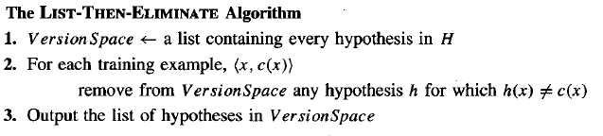

Slide 8

The version space is represented by its most general and least general members.
These members form general and specific boundary sets that delimit the version space within the partially ordered hypothesis space.

Slide 9

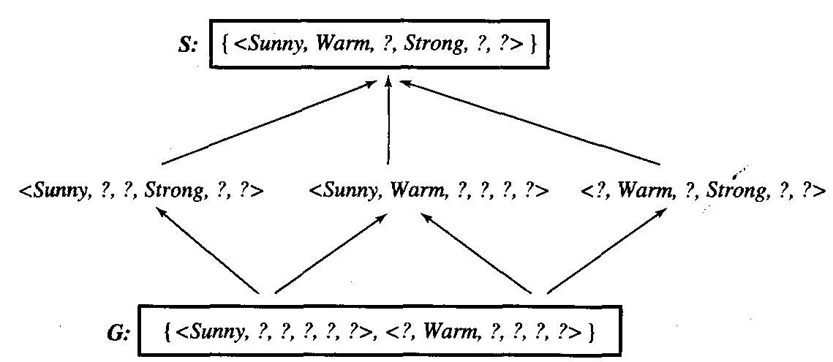
A version space with its general and specific boundary sets.

Slide 10
The version space includes all six hypotheses shown here, but can be represented more simply by S and G.
Arrows indicate instances of the more-general-than relation.
This is the version space for the Enjoysport concept learning problem and training examples

Slide 11

The CANDIDATE-ELIMINATION Learning Algorithm computes the version space containing all hypotheses from H that are consistent with an observed sequence of training examples.
It begins by initializing the version space to the set of all hypotheses in H; that is, by initializing the G boundary set to contain the most general hypothesis in H

Slide 12
Go ← {(?, ?, ?, ?, ?, ?)}
and initializing the S boundary set to contain the most specific (least general) hypothesis
So ← { (Ø,Ø,Ø,Ø,Ø,Ø) }
These two boundary sets delimit the entire hypothesis space, because every other hypothesis in H is both more general than So and more specific than Go.

Slide 13
As each training example is considered, the S and G boundary sets are generalized and specialized, respectively, to eliminate from the version space any hypotheses found inconsistent with the new training example.
After all examples have been processed, the computed version space contains all the hypotheses consistent with these examples and only these hypotheses.

Slide 14

Initialize G to the set of maximally general hypotheses in H
Initialize S to the set of maximally specific hypotheses in H
For each training example d, do
If d is a positive example
  Remove from G any hypothesis inconsistent with d
  For each hypothesis s in S that is not consistent with d
    Remove s from S
    Add to S all minimal generalizations h of s such that
      h is consistent with d, and some member of G is more general than h
    Remove from S any hypothesis that is more general than another hypothesis in S

Slide 15
If d is a negative example
  Remove from S any hypothesis inconsistent with d
  For each hypothesis g in G that is not consistent with d
    Remove g from G
    Add to G all minimal specializations h of g such that
      h is consistent with d, and some member of S is more specific than h
    Remove from G any hypothesis that is less general than another hypothesis in G

Slide 16

The boundary sets are first initialized to Go and So, the most general and most specific hypotheses in H, respectively.
In these first two steps, positive training examples may force the S boundary of the version space to become increasingly general.
Negative training examples play the complimentary role of forcing the G boundary to become increasingly specific.

Slide 17
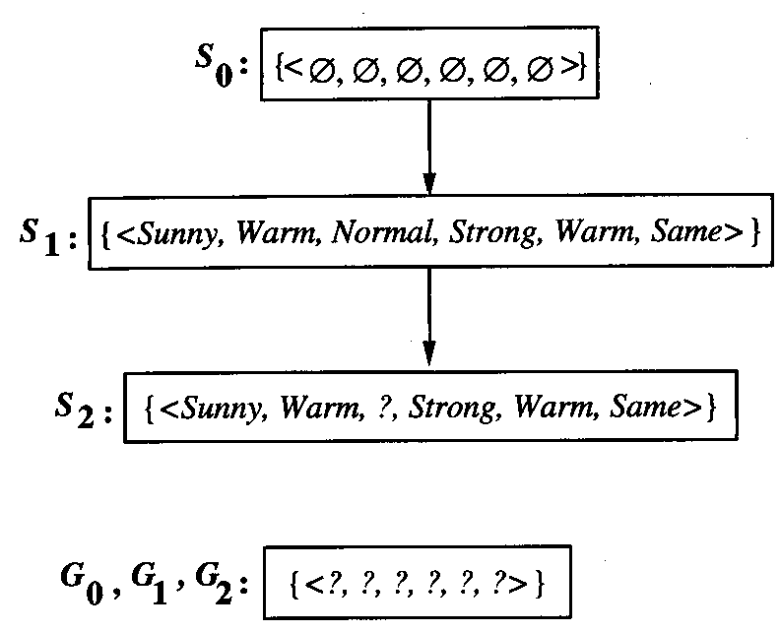
Training examples:
1 . <Sunny, Warm, Normal, Strong, Warm, Same>, Enjoy Sport = Yes
2 . <Sunny, Warm, High, Strong, Warm, Same>, Enjoy Sport = Yes

Slide 18
When the first training example is presented (a positive example in this case), the CANDIDATE-ELIMINATION Algorithm checks the S boundary and finds that it is overly specific-it fails to cover the positive example.
The boundary is therefore revised by moving it to the least more general hypothesis that covers this new example.
This revised boundary is shown as S1 in Figure

Slide 19
No update of the G boundary is needed in response to this training example because Go correctly covers this example.
When the second training example (also positive) is observed, it has a similar effect of generalizing S further to S2, leaving G again unchanged (i.e., G2 = GI = GO).
Notice the processing of these first two positive examples is very similar to the processing performed by the FIND-S algorithm.

Slide 20

The CANDIDATE-ELIMINATION Algorithm will converge toward the true target concept provided it is given accurate training examples and provided its initial hypothesis space contains the target concept.
What if the target concept is not contained in the hypothesis space?
Can we avoid this difficulty by using a hypothesis space that includes every possible hypothesis?

Slide 21
How does the size of this hypothesis space influence the ability of the algorithm to generalize to unobserved instances?
How does the size of the hypothesis space influence the number of training examples that must be observed?
These are fundamental questions for inductive inference in general.

Slide 22
Here we examine them in the context of the CANDIDATE-ELIMINATlON-Algorithm.
As we shall see, though, the conclusions we draw from this analysis will apply to any concept learning system that outputs any hypothesis consistent with the training data.

Slide 23

Suppose we wish to assure that the hypothesis space contains the unknown target concept.
The obvious solution is to enrich the hypothesis space to include every possible hypothesis.
To illustrate, consider again the EnjoySport example in which we restricted the hypothesis space to include only conjunctions of attribute values.

Slide 24
Because of this restriction, the hypothesis space is unable to represent even simple disjunctive target concepts such as "Sky = Sunny or Sky = Cloudy.“
In fact, given the following three training examples of this disjunctive hypothesis, our algorithm would find that there are zero hypotheses in the version space.

Slide 25
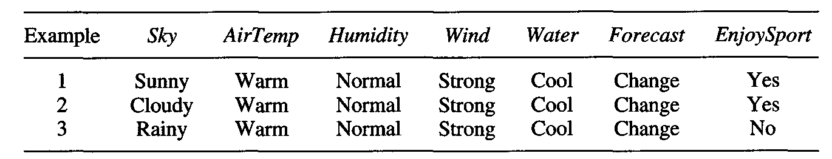
To see why there are no hypotheses consistent with these three examples, note that the most specific hypothesis consistent with the first two examples and representable in the given hypothesis space H is
S2 : (?, Warm, Normal, Strong, Cool, Change)

Slide 26
This hypothesis, although it is the maximally specific hypothesis from H that is consistent with the first two examples, is already overly general: it incorrectly covers the third (negative) training example.
The problem is that we have biased the learner to consider only conjunctive hypotheses.
In this case we require a more expressive hypothesis space.

Slide 27

The obvious solution to the problem of assuring that the target concept is in the hypothesis space H is to provide a hypothesis space capable of representing every teachable concept
In general, the set of all subsets of a set X is called the power set of X.

Slide 28
In the EnjoySport learning task, for example, the size of the instance space X of days described by the six available attributes is 96.
How many possible concepts can be defined over this set of instances?

Slide 29
In general, the number of distinct subsets that can be defined over a set X containing 1x1 elements (i.e., the size of the power set of X) is 2^{1X1}.
Thus, there are 2⁹⁶, or approximately 10²⁸ distinct target concepts that could be defined over this instance space and that our learner might be called upon to learn.

